Slide 1

Integrating Global Species Distributions, Remote Sensing and Climate Station Data to Assess Biodiversity Response to Climate Change
Adam Wilson & Walter Jetz, Yale University
on behalf of PIs W. Jetz, R. Guralnick, B. McGill, R. Nemani, F. Melton
April 26, 2012

Slide 2
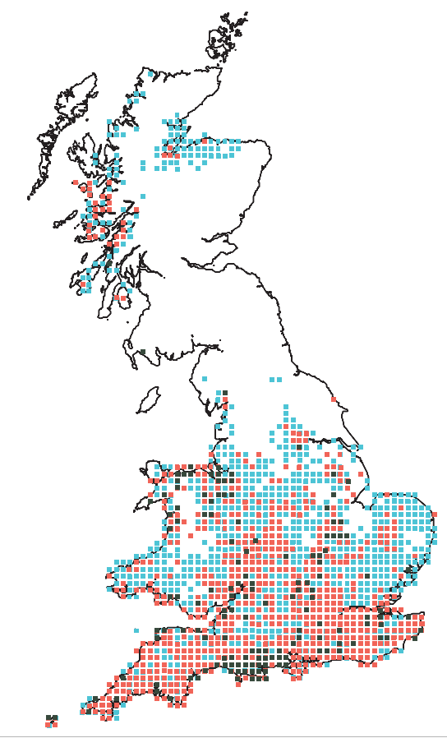
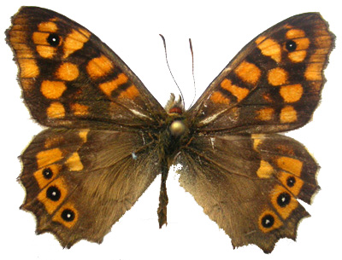
Scattered examples of range shifts…
… but no global analysis across taxa
1970–1997
1940–1969
1915–1939
http://www.nymphalidae.net/
20th century changes in the range of
butterfly Pararge aegeria
Nature (1999) 399:579:583
Great Britain

Slide 3
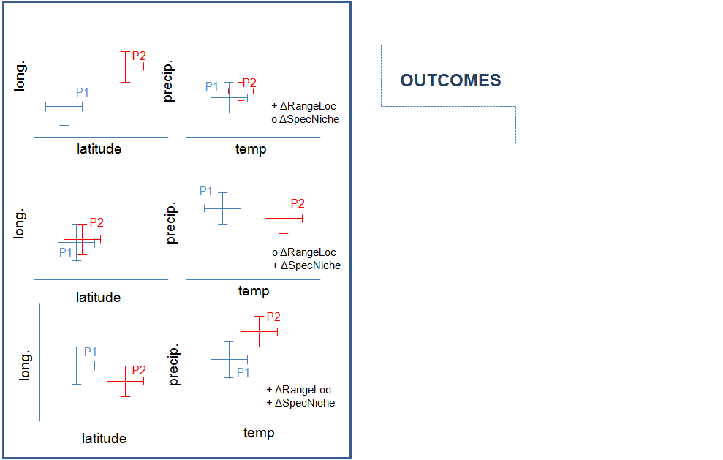
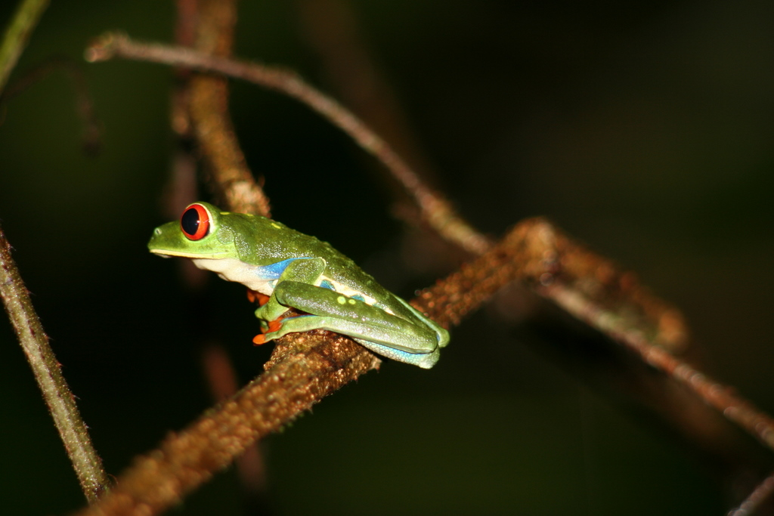
Assessing species distribution responses to recent environmental change
Question:
How much change in the:
geographic and
multivariate niche space of (best-sampled) species?

Slide 4
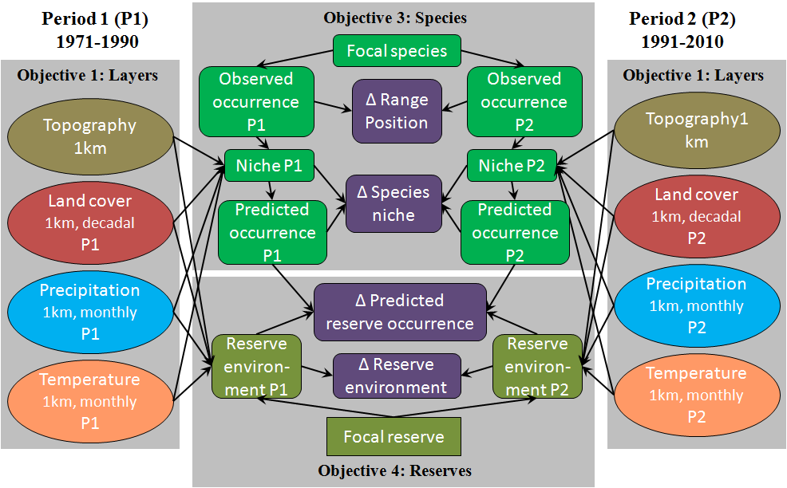
Project Overview

Slide 5
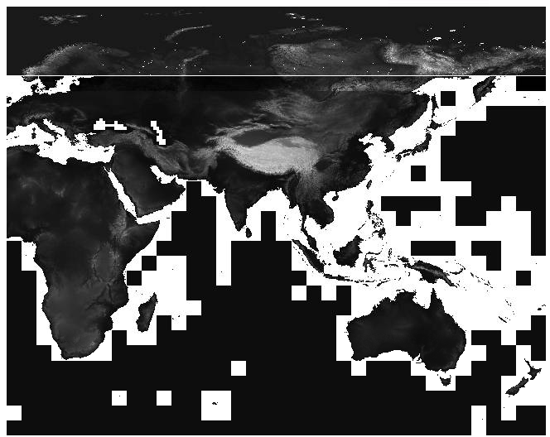
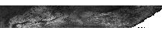
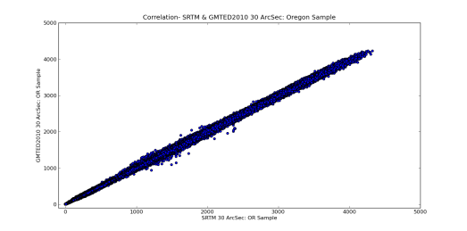
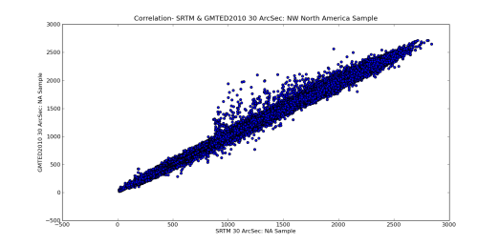
Global 90m DEM from SRTM & ASTER data
Aster GDEM2
ASTER/SRTM Blend using Gaussian function at overlap area: 55N-60N
SRTM
2) Accuracy assessment: Compare to GMTED2010 (1km resolution)
GMTED2010
GMTED2010
Global DEM
Global DEM
Oregon, USA: Datasets should match
Northwestern Canada: Data in blend zone

Slide 6
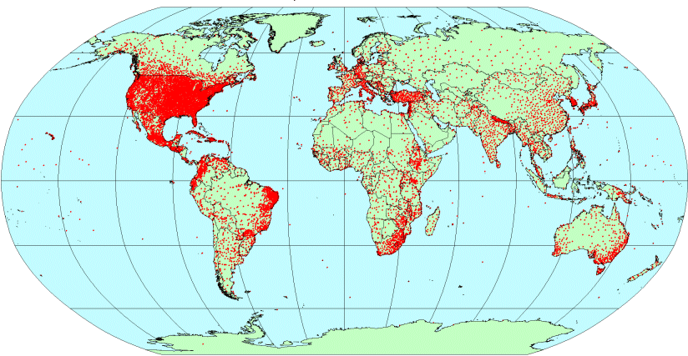
WorldClim.org
1km Monthly climatology >6,500 citations since 2006
Temperature stations included in WorldClim
Notes:
Worldclim by far the most popular source of climate data for biological research
1km resolution is appealing, but as shown above is misleading for many areas of the globe
We plan to provide both improved spatial accuracy by incorporating satellite data and timeseries (rather than just climates)

Slide 7
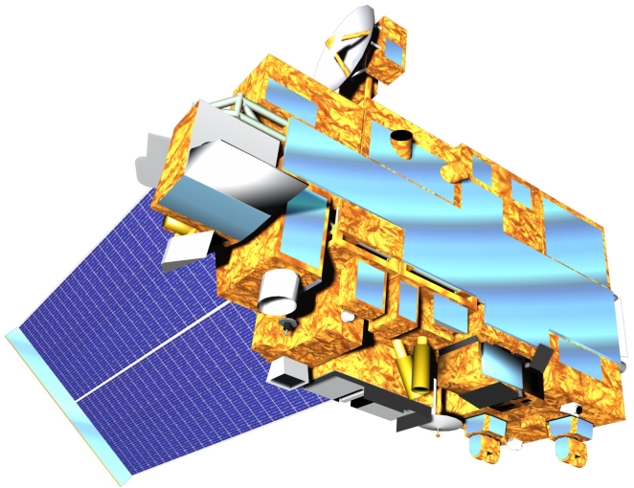
Satellite-Station Data Fusion
Goal: Develop daily 1km surfaces of tmax, tmin, and ppt with MODIS and climate station data (1970-2011).
Two statistical approaches:
Interpolate raw values day-by-day using remotely sensed information (LST, clouds, topography, land cover, etc.) as covariates
Climate-aided interpolation
  Monthly climatologies (2000-2011) from MODIS and station means
  Interpolate daily station anomalies

Slide 8
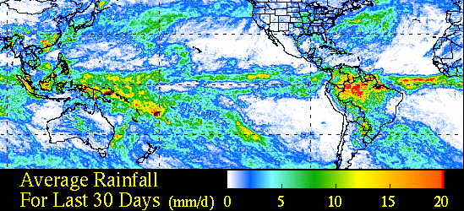
Satellite Weather Products
Temperature:
MODIS LST (MOD11A1)
Precipitation:
TRMM (1/4º)
MODIS Cloud Product (MOD06_L2)

Slide 9
Interpolation Methods
(raw & climate-aided)
Generalized Additive Models (GAMs)
Geographically weighted regression (GWR)
Thin-plate splines
Kriging/co-kriging (conventional and Bayesian)

Slide 10
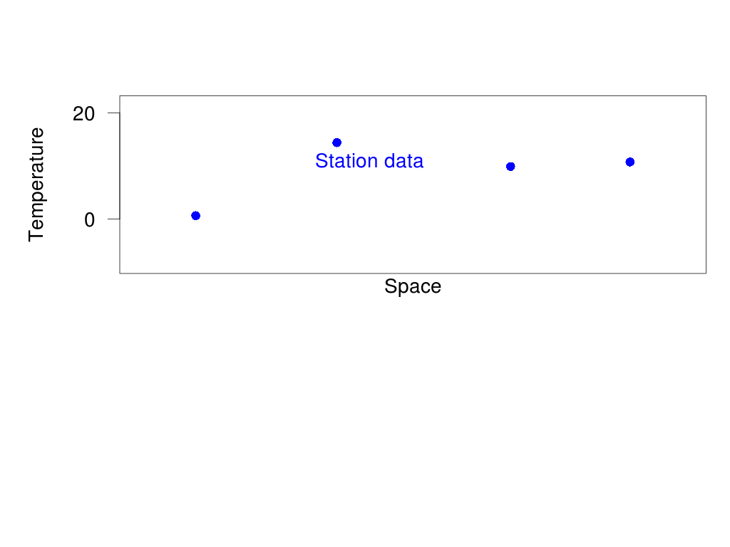
Two approaches: raw and climate-aided

Slide 11
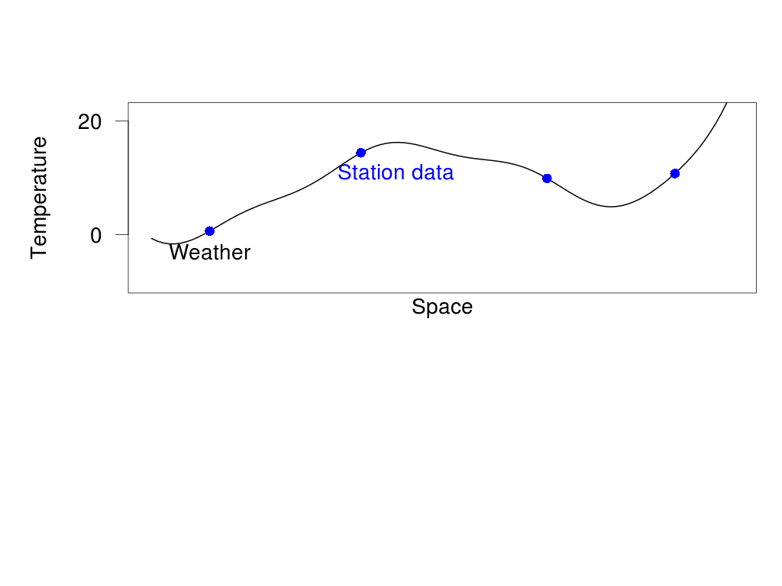
Two approaches: raw and climate-aided

Slide 12
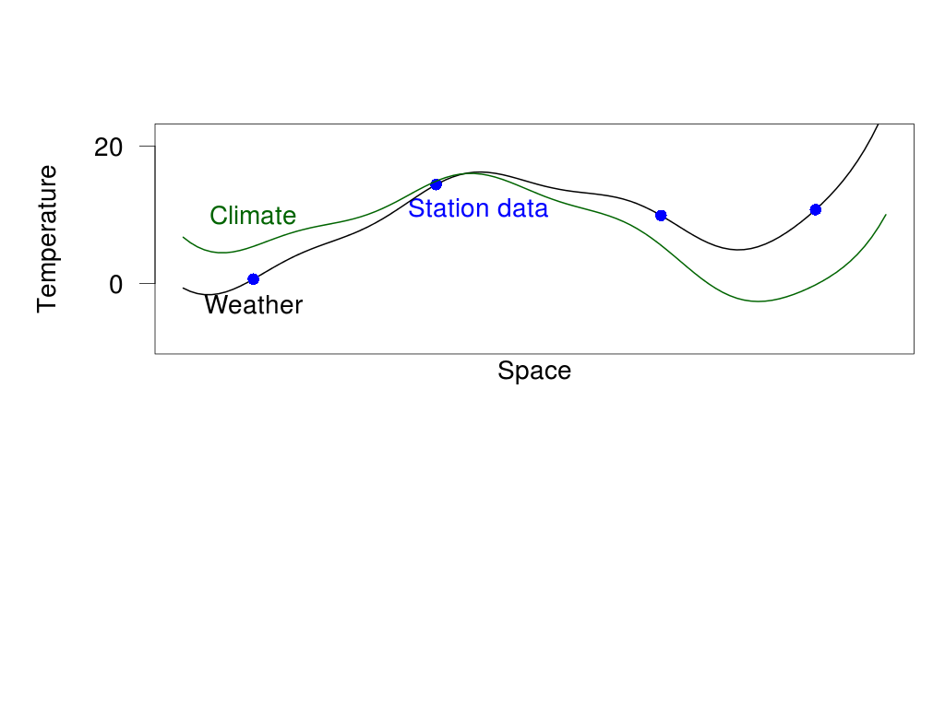
Two approaches: raw and climate-aided

Slide 13
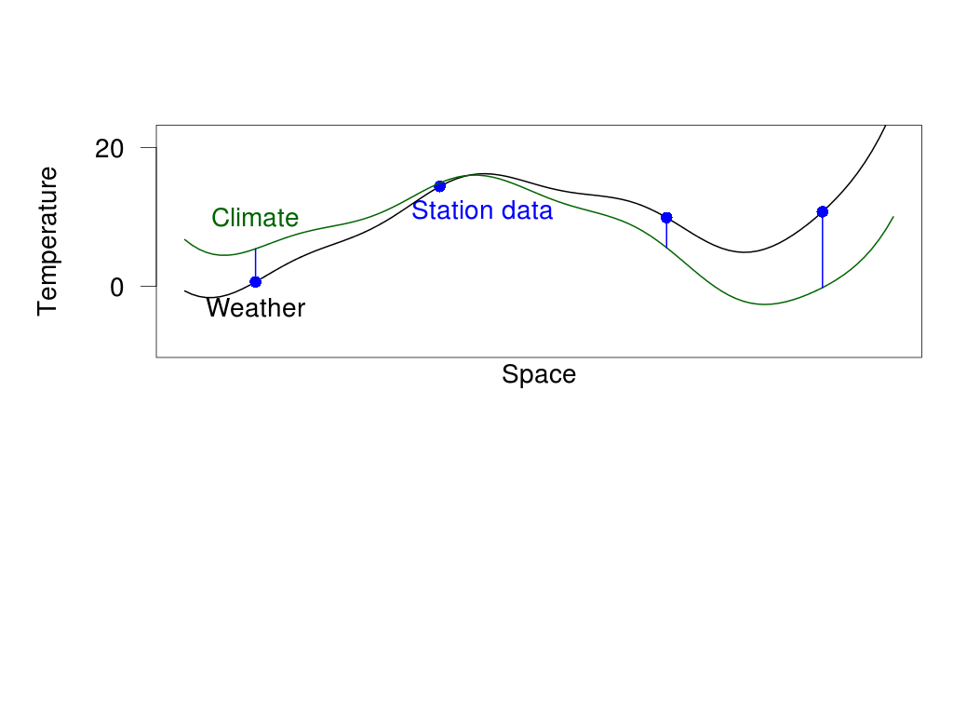
Two approaches: raw and climate-aided

Slide 14
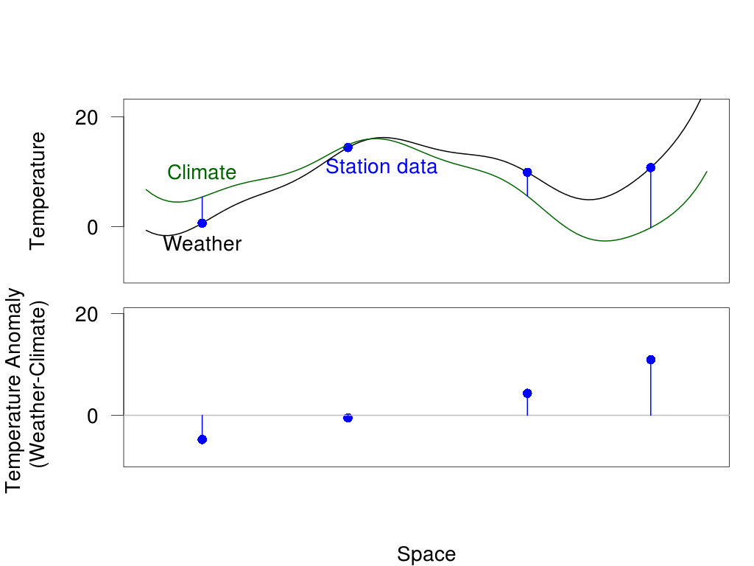
Two approaches: raw and climate-aided

Slide 15
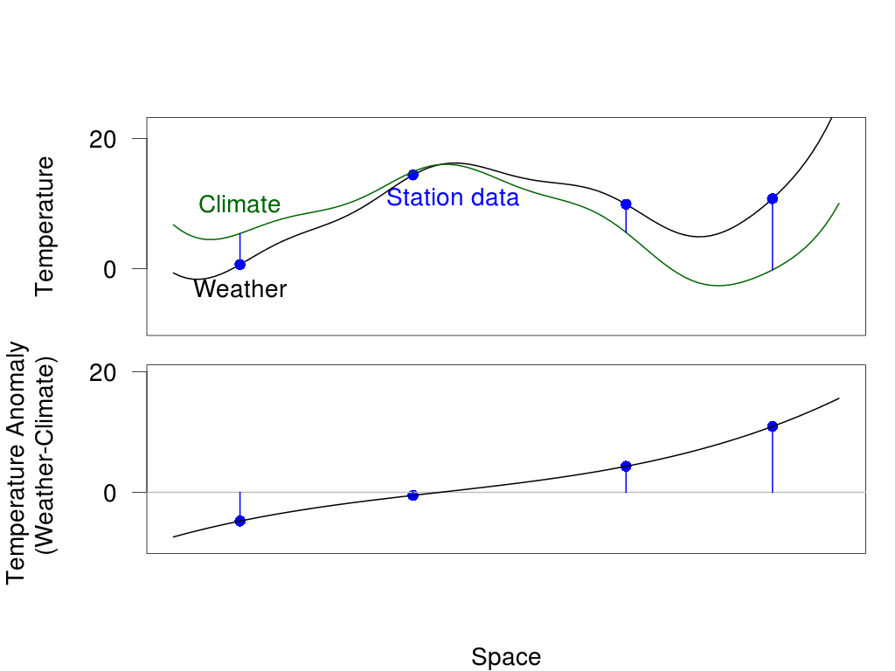
Two approaches: raw and climate-aided
Much smoother surface

Slide 16
Climate-aided Interpolation
spatial variability within the climatology accounts for most of the temporal between-station variability (Willmott & Robeson, 1995)
anomalies are strongly correlated out to distances of the order of 1000 km (Hansen and Lebede, 1987)
anomalies are relatively free of the considerable topography-forced spatial variability (Willmott & Robeson, 1995)
Di Luzio, et. al (2008); Hunter & Meentemeyer (2005); Perry, et. al (2005); Willmott & Robeson (1995)

Slide 17
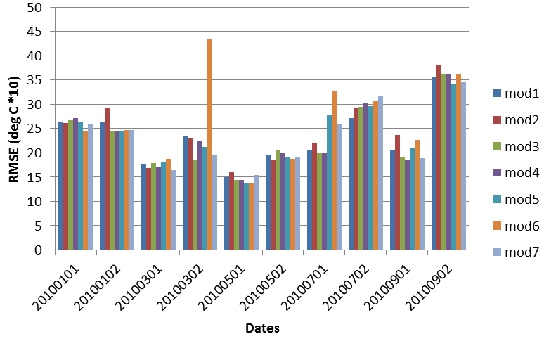
Case Study: Oregon
Model Comparison (RMSE of validation data across models)

Slide 18
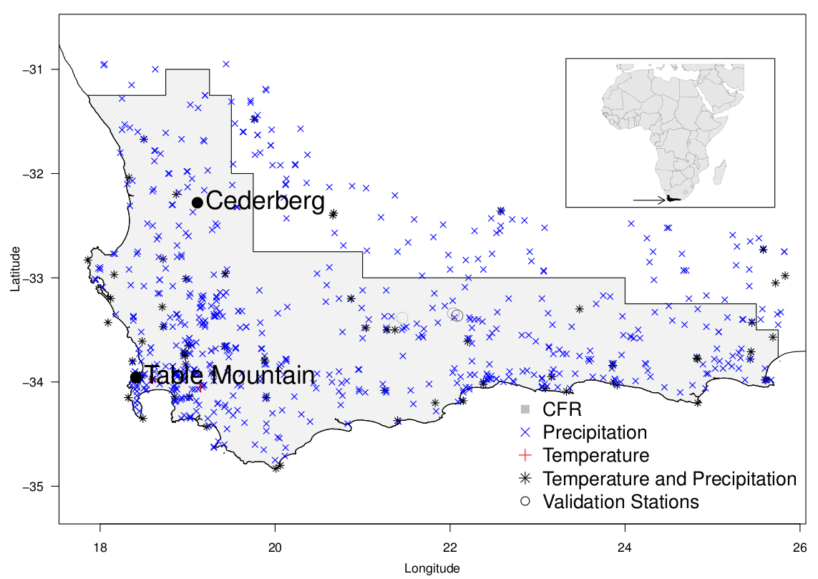
Case Study: South Africa
1980-2010 daily interpolations at ~1.5km resolution in South Africa
Used existing climate surfaces, no satellite data

Slide 19
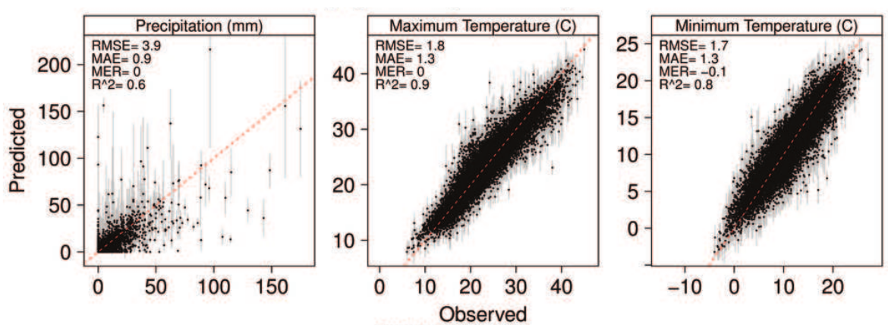
Case Study: South Africa
Predictive Accuracy for Validation Stations
Successful prediction of:
97% dry days (≤ 2mm)
66% wet days

Slide 20

Next Steps: Phase 1
Develop monthly climatologies using MODIS LST (MOD11A1) and cloud data (MOD06_L2)
Finalize comparison of interpolation methods
Expand analysis to other focal regions
  Oregon, South Africa, Costa Rica, Norway
Generate layers globally

Slide 21
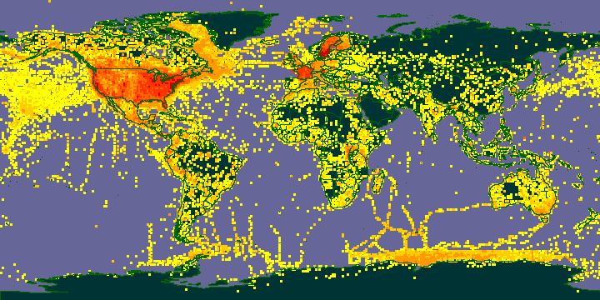
Available species point occurrences
GBIF: 43,700,000 bird records …
Geographically and environmentally biased
Need extensive cleaning/processing before use

Slide 22
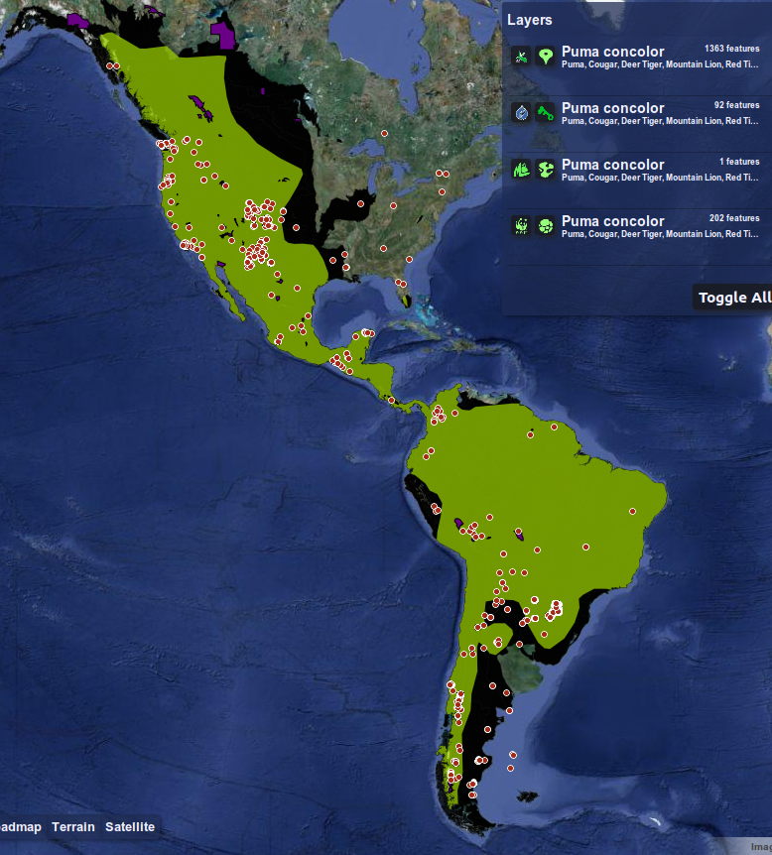
Map of Life
Mobilizing multi-source biodiversity data:
Point records
Expert range maps
Species lists
Facilitates quality control on large datasets
Jetz, McPherson, & Guralnick (2012) Integrating biodiversity distribution knowledge: toward a global map of life. Trends in Ecology & Evolution, 27(3), 151–159
Type | Source | Amphibians | Birds | Mammals | Reptiles | Fish
Points | GBIF | 1.8m | 132.4m | 4.4m | 1.7m
Expert Maps | IUCN/others | 6k | 10k | 4k |  | 1k
Local Inventories | Various | 2k | 48k | 10k
Regional Checklists | WWF | 12k | 201k | 68k | 68k

Slide 23
Assessing Change: historical species observations
Class | Species | Avg. records per species 1971‐1990 | Avg. records per species 1991‐2010
Amphibia | 126 | 831 | 567
Aves | 1,286 | 3,075 | 28,044
Mammalia | 360 | 834 | 1,070
Reptilia | 119 | 379 | 605

Slide 24


Extended team and funding
Mark Schildhauer, Jim Regetz, Benoit Parmentier, George Cooper
mappinglife.org

